Slide 1
Youth informal organizations

Slide 2
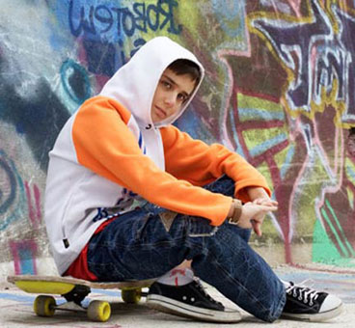

Slide 3
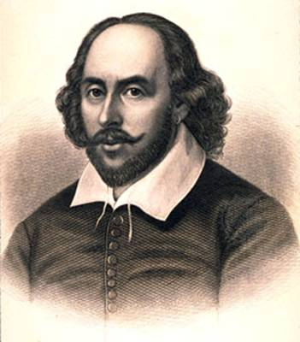
A MADRIGAL
Crabbed Age and Youth Cannot live together: Youth is full of pleasance, Age is full of care; Youth like summer morn, =morning Age like winter weather, Youth like summer brave, великолепный Age like winter bare; пустой Youth is full of sport.
Возраст и Юность вместе не могут;
Юность в забавах, Возраст в тревогах.
Юность - как летнего утра дыхание,
Возраст – как зимней поры увядание.
Юность, как лето, теплом приобнимет,
С Возрастом зимняя стужа нахлынет.
В Юности думаешь: жизнь бесконечна!
Возраст попросит оставить беспечность.
Две параллели не могут быть вместе…
Юность! Тобой восхищаюсь! Пою тебе песню!
William Shakespeare
1

Slide 4
Subculture is any group within a larger complex culture who has interests that are different from those of the dominant culture. Subculture is a group with a distinct style and identity. Different subcultures have their own beliefs, value systems, fashion and favourite music.

Slide 5
Youth Movements Ex.40 p.149
the Church-based Boys` Brigade [brɪ'geɪd]
the Boy Scouts [skauts]
the Girl Guide Association [gaɪd əˌsəusɪ'eɪʃ(ə)n]
the Nazi ['nɑːtsɪ] Hitler Youth
the Blackshirts
the Austrian Red Falcons ['fɔː(l)k(ə)ns] cоколы
Octobrist
Pioneer [paɪə'nɪə]
Komsomol ['kɔmsəmɔl]
the Teddy Boys
the Mods [mɔdz]
the Rockers ['rɔkəz]
Skinheads
The Hippies ['hɪpɪz]
The Punk Rockers [pʌŋk 'rɔkəz ]

Slide 6
Titles
Youth Sections in Mass Political Movements
Different Types of Youth Movements
Young People’s Religious Organizations
Post War Youth Cultures
Adult-led Youth Movements

Slide 7
1

Slide 8
The Church-based Boys` Brigade
1Слайд 9

Slide 9
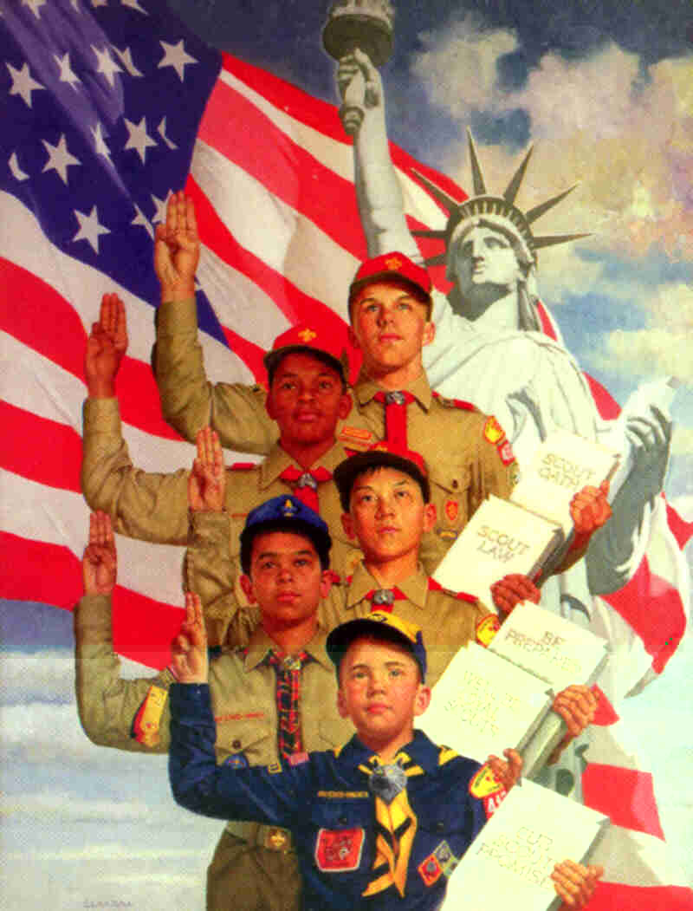
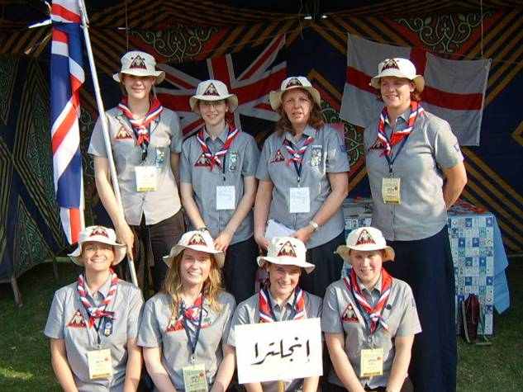
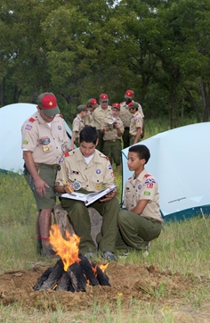
The Boy Scouts The Girl Guide Association
Слайд 91

Slide 10
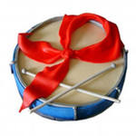
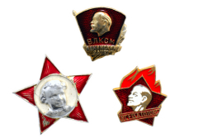
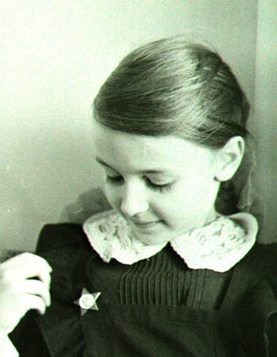
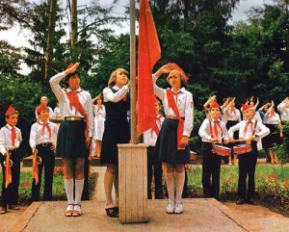
Pioneer, Octobrist, Komsomol groups
1Слайд 9

Slide 11
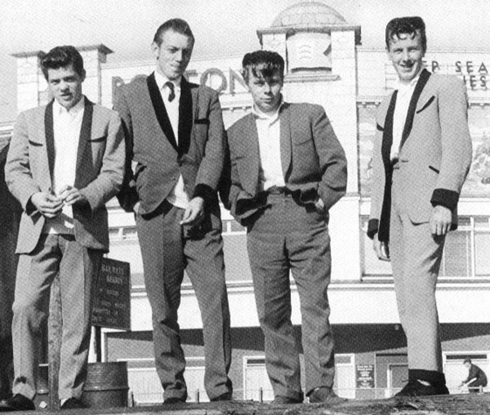
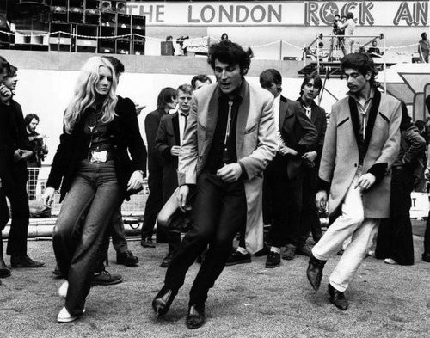
The Teddy Boys
1Слайд 9

Slide 12
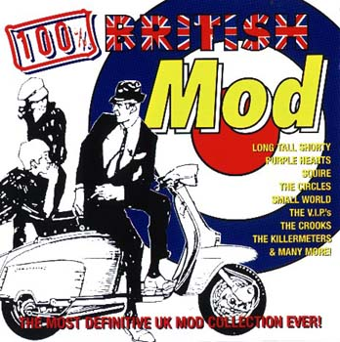
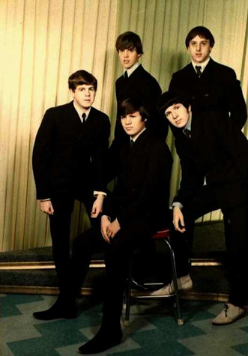
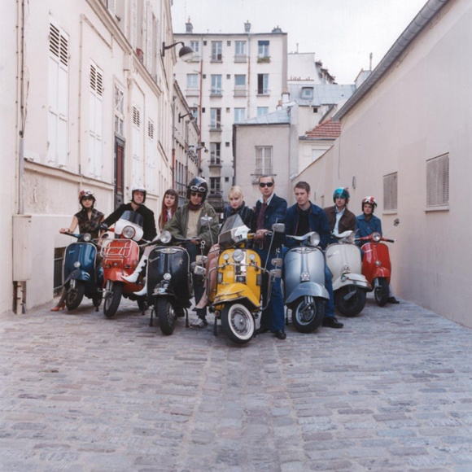
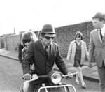
The Mods
1Слайд 9

Slide 13
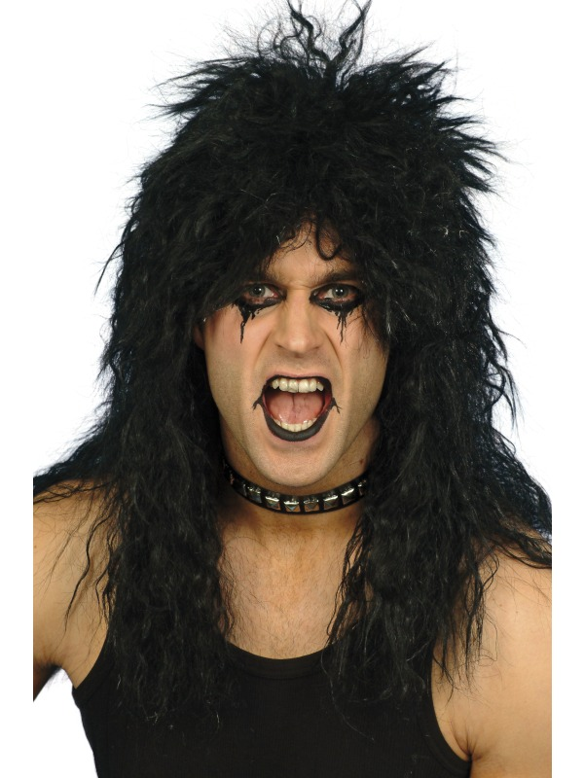
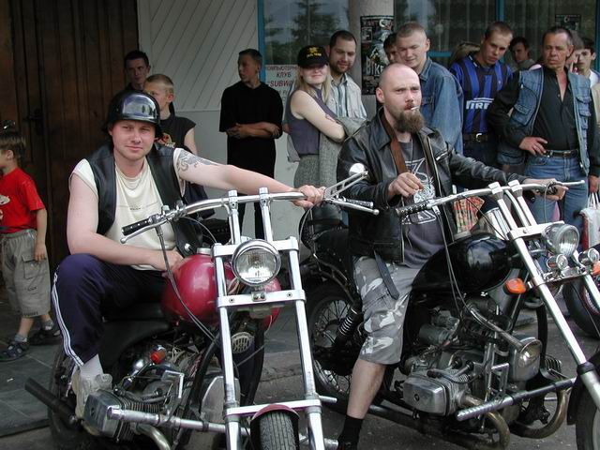
The Rockers
Слайд 9

Slide 14
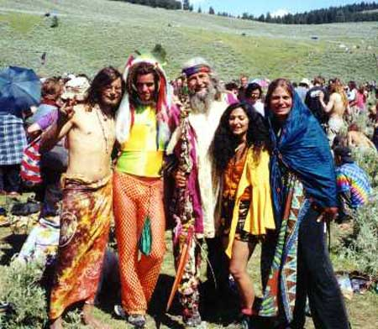
The Hippies
1Слайд 9

Slide 15
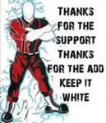
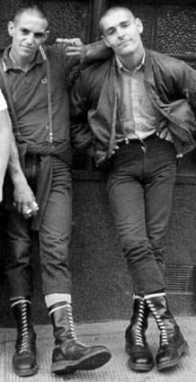
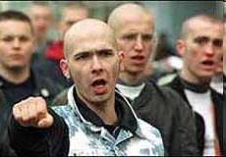
The Skinheads
1

Slide 16
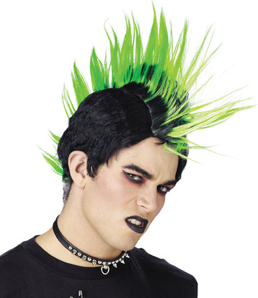
The Punk Rockers
Слайд 91

Slide 17
for and against
What positive and negative features do youth subcultures have?
shocking looks
drug and alcohol addiction
bad image
communication with friends
self-expression
special way of life
common interests
rebellion against the society
rejection of everything
protest against the parents
changing the world to the best
new styles of music
spending spare time
teens’ violence and aggressiveness

Slide 18
Music pause
1.
2.
3.
4.
5.
Punk Rock – Sex Pistols
Techno – Prodigy
Rock’n’Roll – Elvis Presley
Reggae – Bob Marley
Psychedelic Rock – Pink Floyd

Slide 19
The Self-Sufficient Work
Name | When and where it appeared | Motto | Signs and symbols | Exterior And clothes | Music | Features

Slide 20
Who are they?
They wear long jackets, velvet collars, drainpipe trousers and crepe-soled shoes. They were the first of the rebellious working-class youth cults.
They sought to free themselves from societal restrictions, choose their own way, and find new meaning in life.

Slide 21
Who are they?
They have brightly colored hair and wear metal chains.
All persons who ride 2 or 3 motorized vehicles and usually wear leather jackets and army boots.

Slide 22
Who are they?
They are visually identified by their short hair and unique clothing styles. They always say something like “Russia for Russian”, “England for English”, “Germany for German”.
Significant elements of this subculture include fashion (often tailor-made suits); music and motor scooters.

Slide 23
Who are they?
Their motto is "Sure and Steadfast" and the logo is an anchor placed over a Greek cross.
It is a worldwide youth movement of multiple organizations for both boys and girls whose aim is to develop young people physically, spiritually and mentally so that youth may take a constructive place in society.

Slide 24
Wisdom
If there is right in the soul,
There is beauty in the person.
If there is beauty in the person,
There will be harmony in the home.
If there is harmony in the home,
There will be order in the nation.
If there is order in the nation,
There will be peace in the world.

Slide 25
Homework
STUDENT CARD
Give a 3 minute talk on youth subcultures.
Remember to say:
- what youth subcultures you know
- why different subcultures appear
- if subcultures help to express one’s individuality
- if you would like to belong to any teenage subculture (why/why not)

