Slide 1
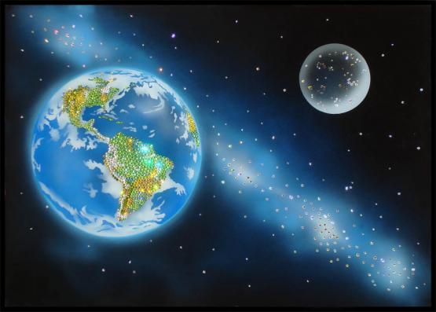
Space exploration
Notes:
Space exploration

Slide 2
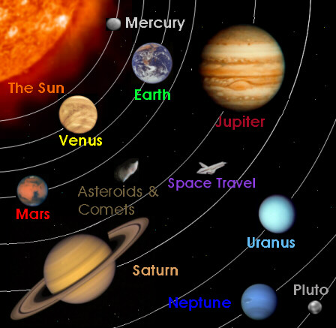

Slide 3
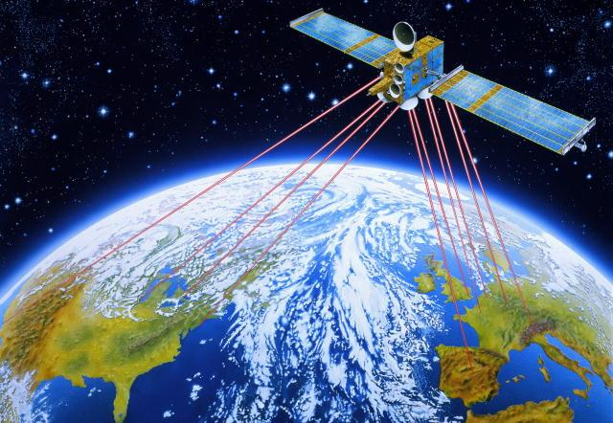

Slide 4
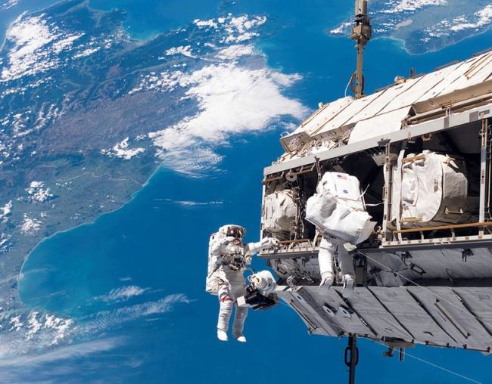

Slide 5
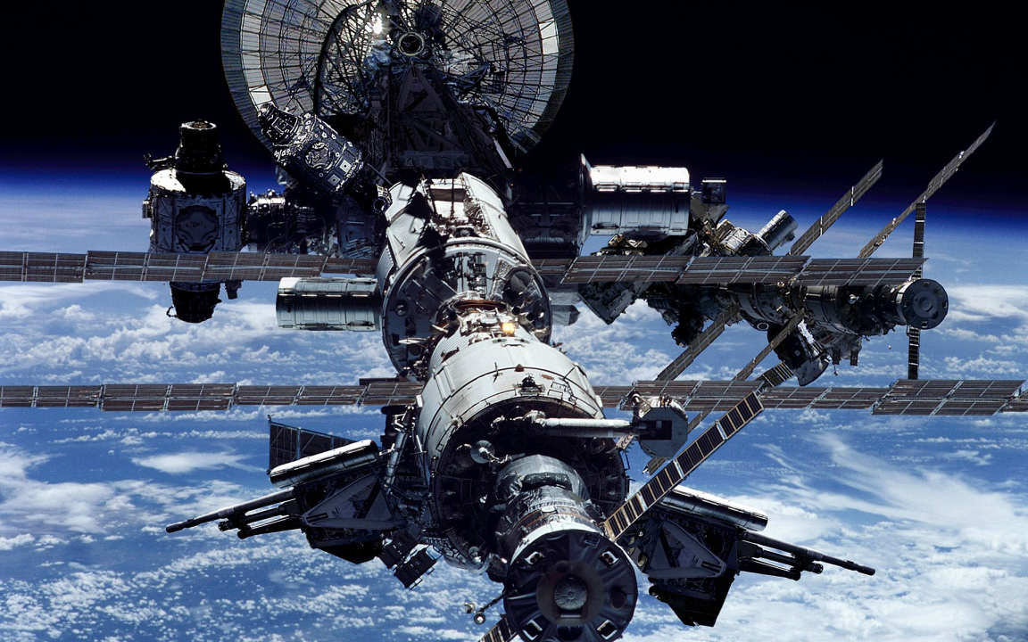

Slide 6
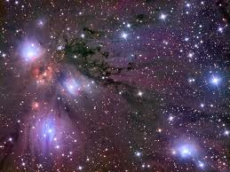

Slide 7
Find the same words in Russian:
Space исследовать, изучать
Exploration космос
To explore исследование
A researcher космический корабль
Launch спутник
Spaceship астронавт
Satellite исследователь
Astronaut запускать

Slide 8
Fill in the gaps with the following words: launched, planets, spaceship, cosmonaut, satellite, explored, research.
The____ flew at the speed of 300 miles a minute.
Yuri Gagarin was the first___ in the world.
The government spends money on scientific____.
I saw ____ and began to move towards it.
They’ve ____ their own solar system.
The Earth is the fifth largest of the nine main ___ in the solar system.
The satellite was ____ into space three days ago.
(Keys: spaceship, cosmonaut, research, satellite, explored, planets, launched)

Slide 9
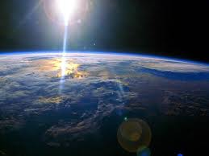

Slide 10
Complete the following sentences.
Ann: And we s… billions of dollars on s… research. This money should be used for medical r… .
Keys: spend, space, research

Slide 11
Complete the following sentences.
Felix: By e… space we may find another p… that we can l… on. We must learn to t… not only about this g… but about f… generations as well.
Keys: exploration, planet, live, think, generation, future

Slide 12
Complete the following sentences.
Linda: Would we a… to ruin other p… for our needs? Of course, we w… . People will think that there is another planet for us in s… .
Keys : agree, planet, would, space

Slide 13
Why does the country spend much money on space research?
Why does Felix think that the situation is serious?
Linda thinks that people don’t take care of nature, doesn’t she?
Is it easy to ruin our planet and to find another planet for people in space?

Slide 14
