Slide 1
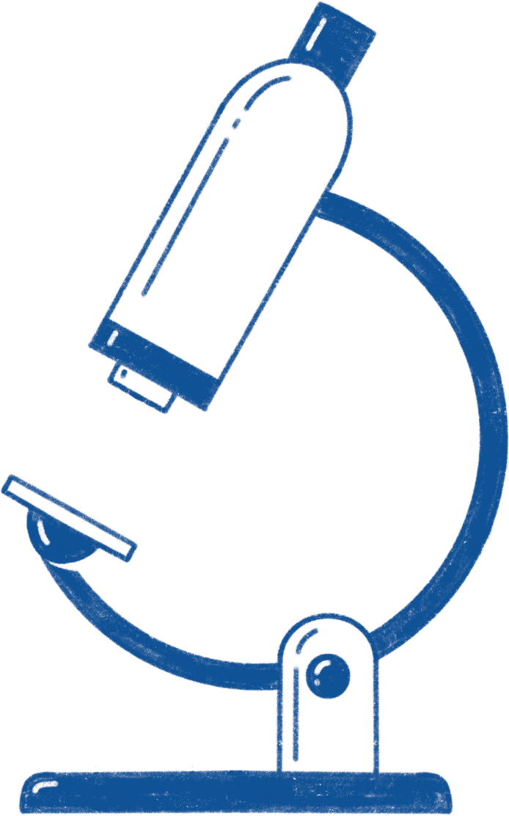
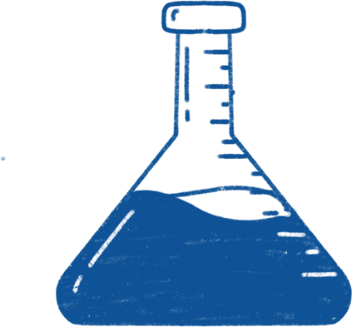
Leonardo da Vinci
scientist, artist, inventor(1452-1519)

Slide 2
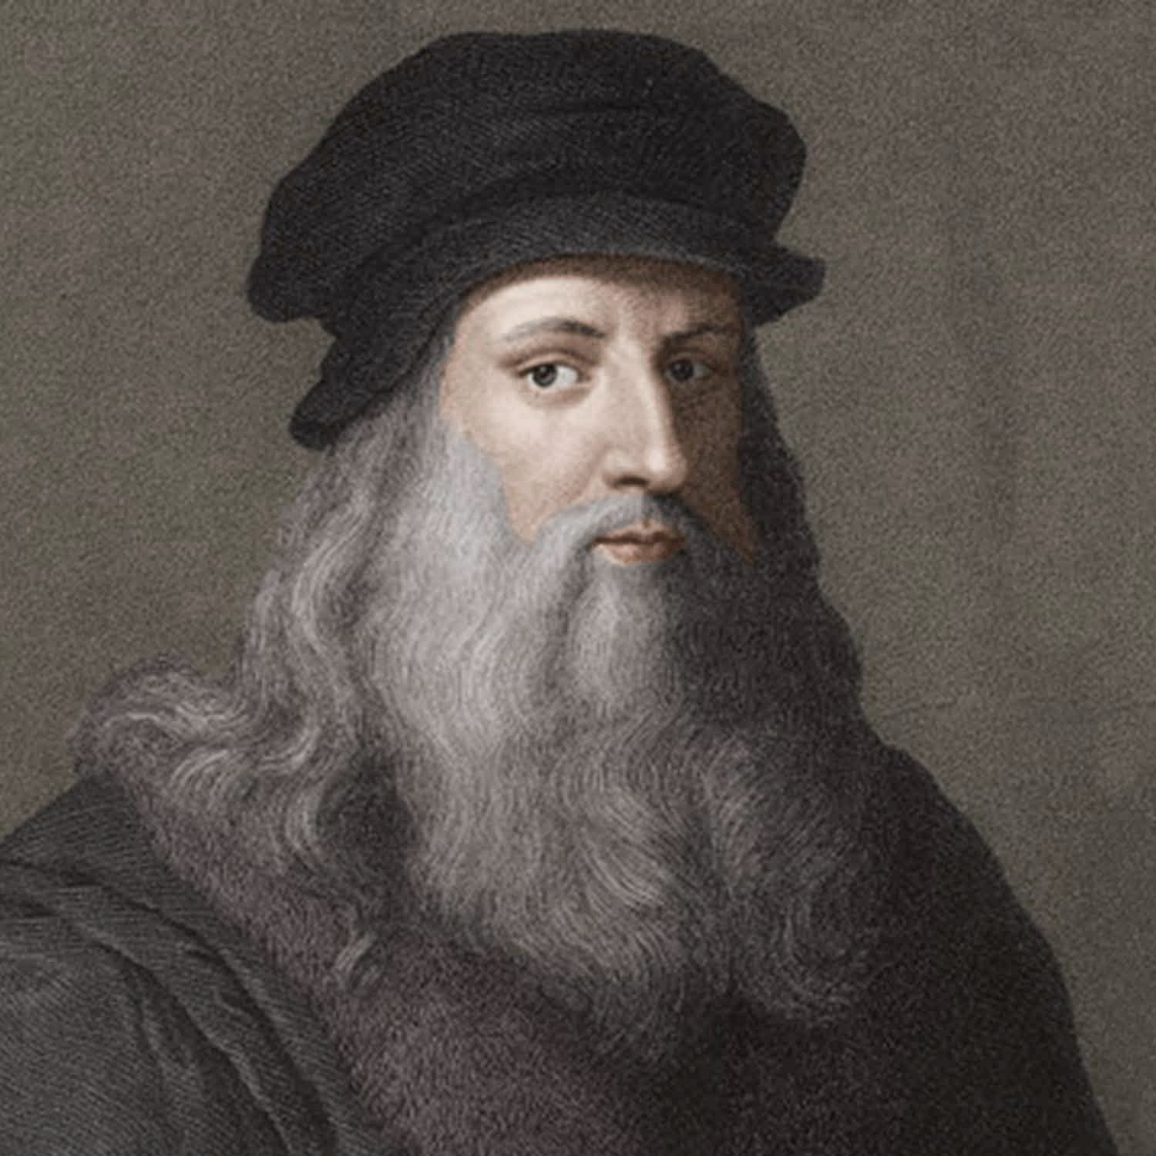
Painter, sculptor, architect, naturalist, inventor, engineer, writer, thinker, musician, poet. If you list only these areas of application of talent, without naming the person to whom they relate, anyone will say: Leonardo da Vinci.
Da Vinci was a figure of his time, but the real glory came many centuries after his death.

Slide 3
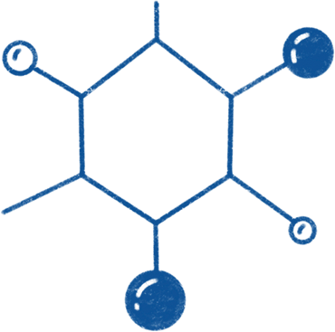
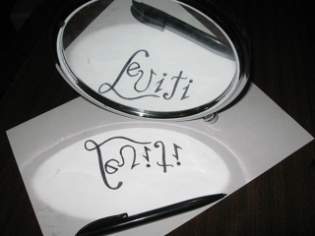
It is noteworthy that da Vinci's notes are made in the so-called "mirror" font. Until now, disputes have not subsided about why the scientist needed to keep records in this way.

Slide 4
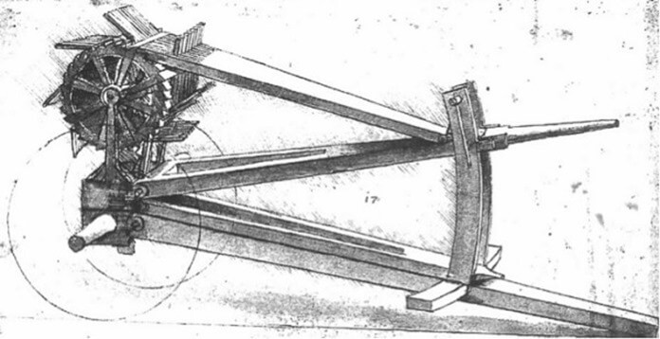
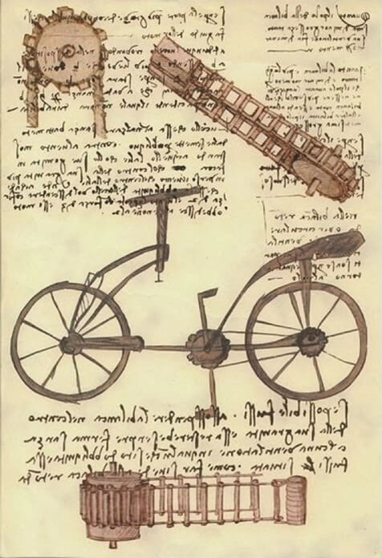
Most famous inventions
1
2
garlic crusher
Bike

Slide 5
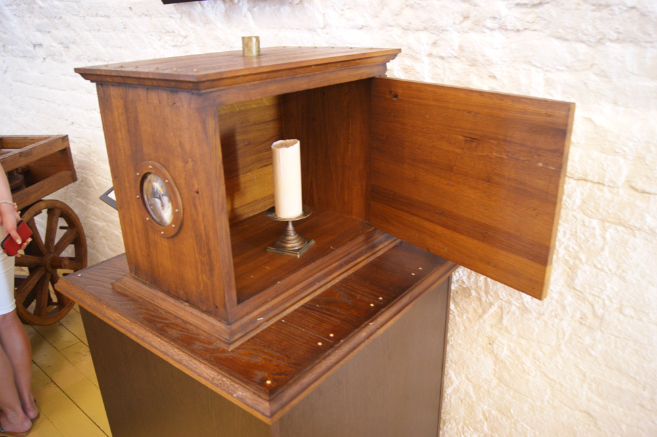
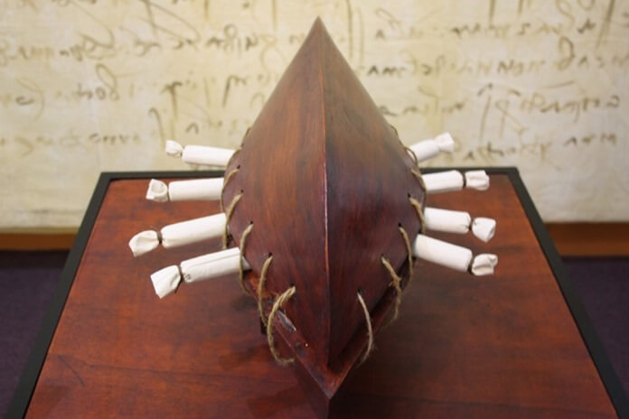
3
4
spotlight
submarine

Slide 6
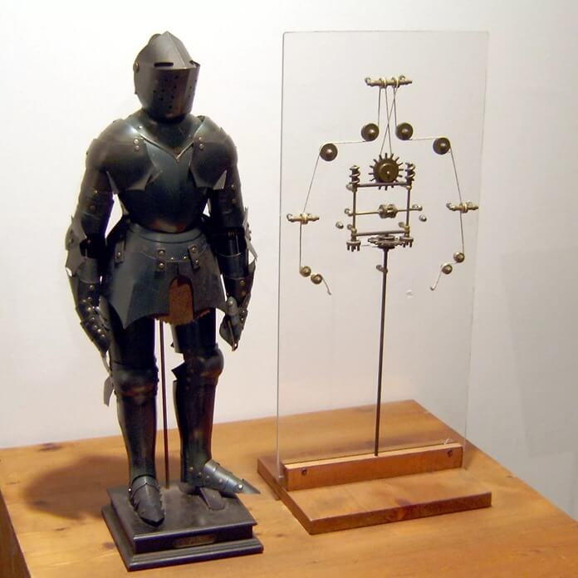
5
Robot Knight
The robot, powered by internal mechanisms ,presumably, had the ability to both sit down and stand up, while at the same time demonstrating its ability to move its head.

Slide 7
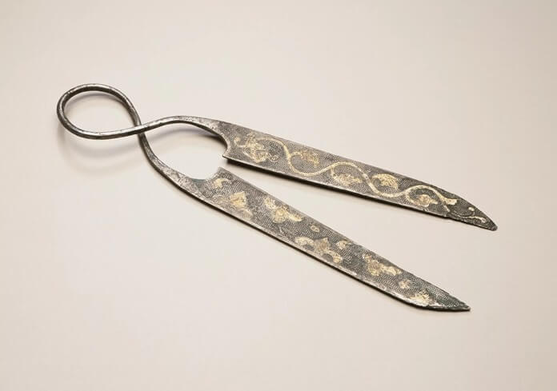
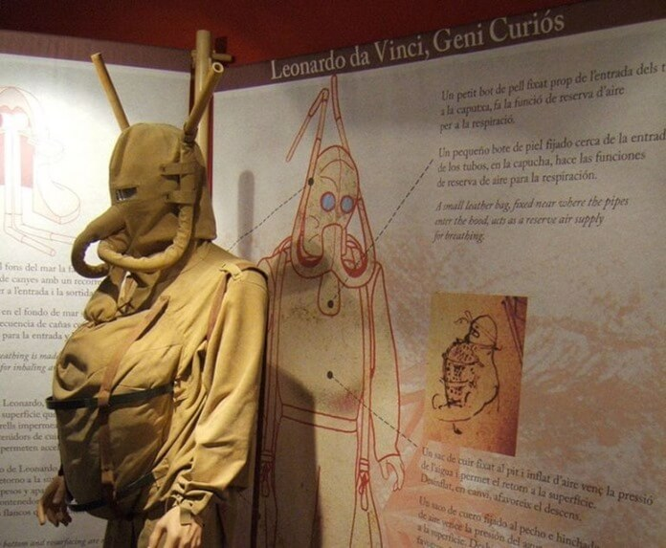
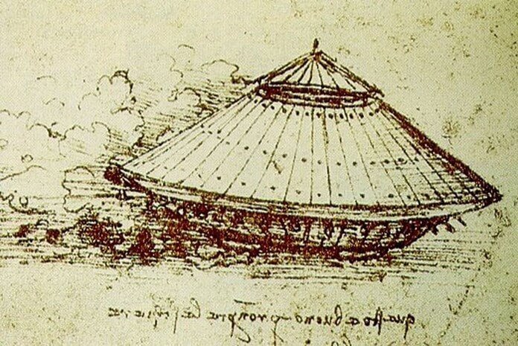
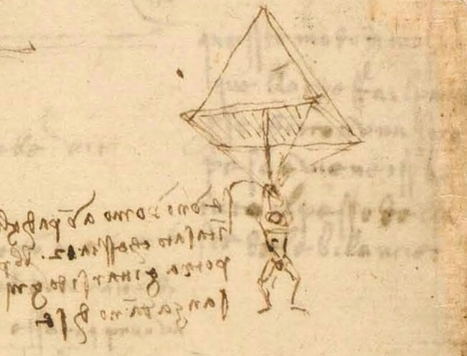
As well as…
6. scissors
7. Diving equipment
8. Armored car
9. Parachute

Slide 8
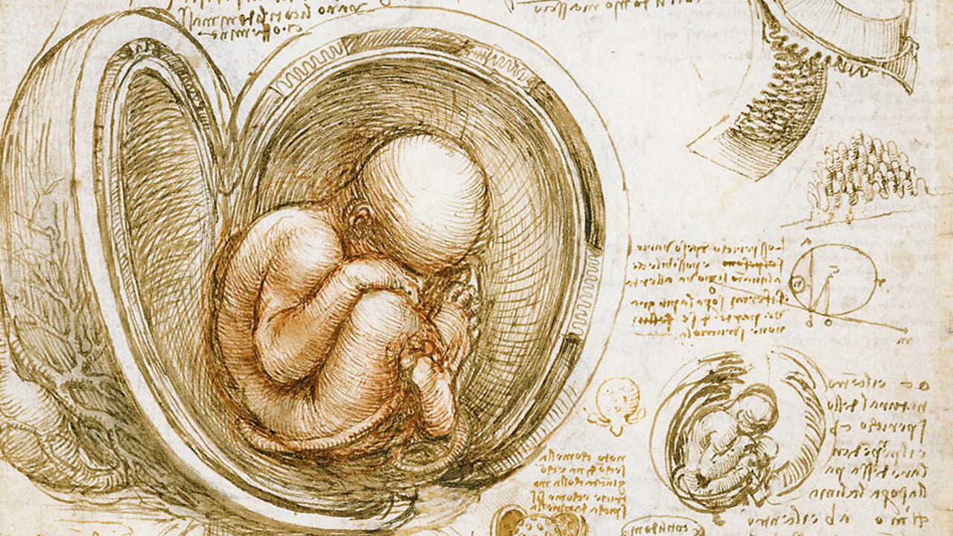
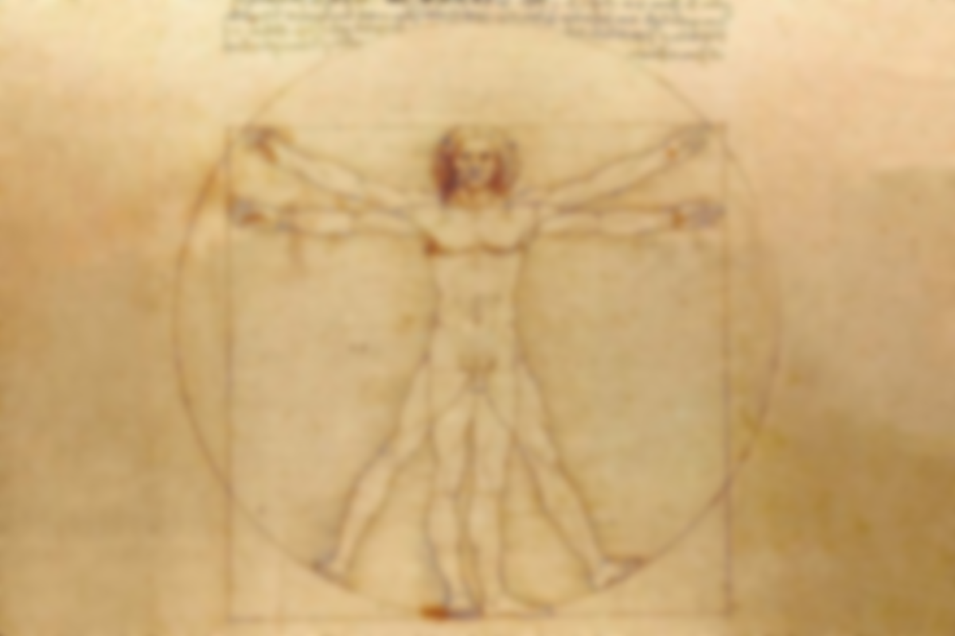
Аchievements in anatomy
The artist perfectly depicted the skeleton, Leonardo was the first person who accurately and correctly drew the proportions and shapes of parts of the human skeleton. The scientist first suggested that the sacrum of the spine consists of 5 vertebrae, and not 3

